Slide 1
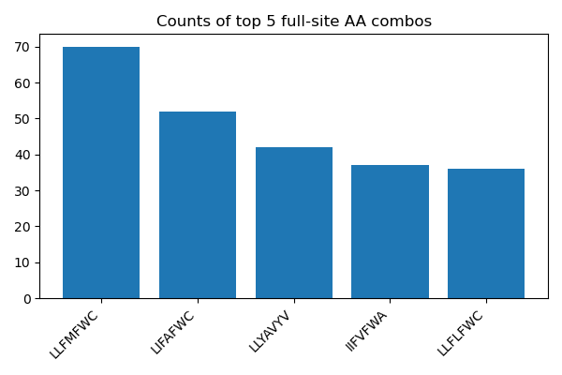
AcK Library Analysis with Script_V1
Reference:
 | 121 | 125 | 126 | 129 | 168 | 206 | 223
pBK Ma Pyl RS WT | L | L | Y | M | V | Y | A
Top 5 full proteins from the new script:
Top 5 full proteins from Ricks Analysis:
Full Sequence | Frequency
LLFMFWC | 31
LIFAFWC | 19
LIFAFWA | 15
LLYAFWC | 15
LLYAVYV | 14
The increased number (depth) could be due to the more extensive Muscle5 alignment along with
keeping all the sequences and marking their phred qualities rather than throwing out lower quality sequences
New Script Analysis done on
X5DWGR #1 SAL pBK_Post POS SEL 10 mM AcK.fastq
Ricks Analysis done on X5DWGR_1_SAL_pBK_AcK_post__POS_SEL.fastq

Slide 2
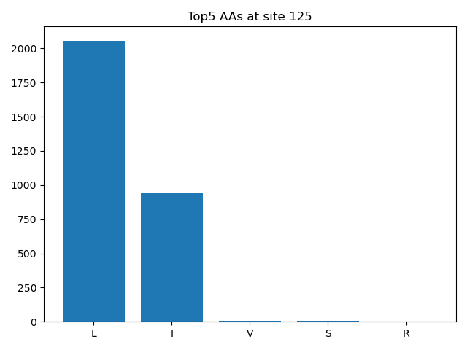
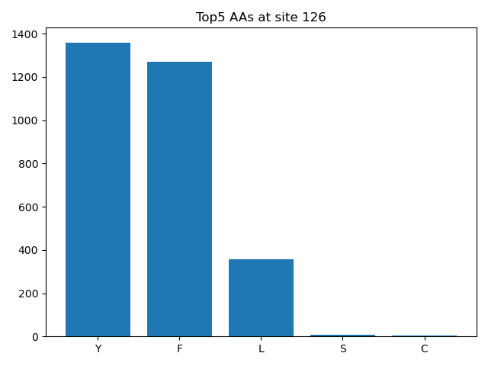
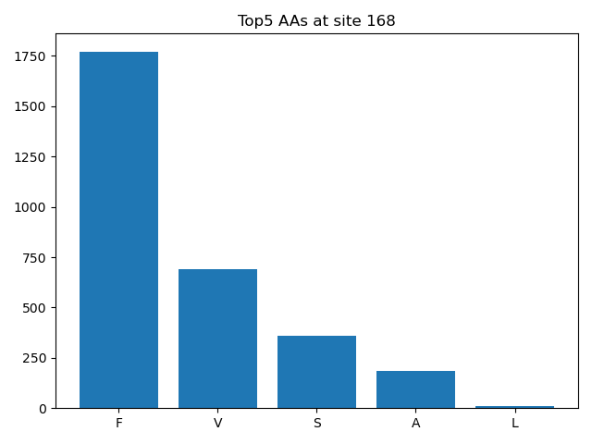
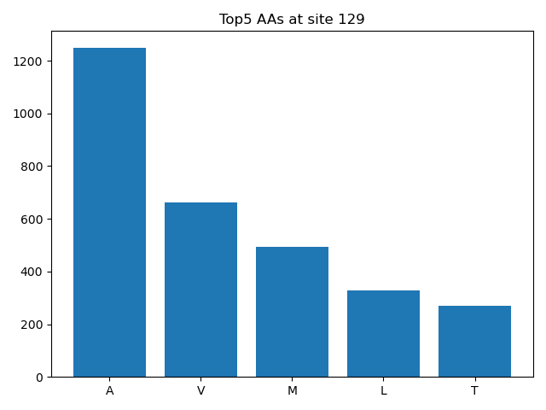
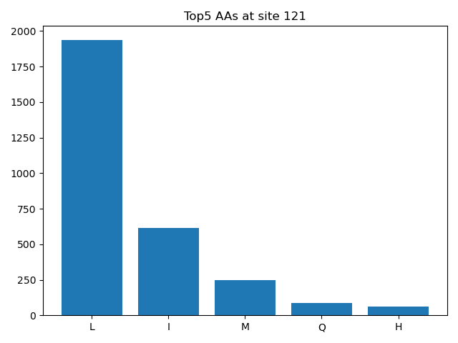
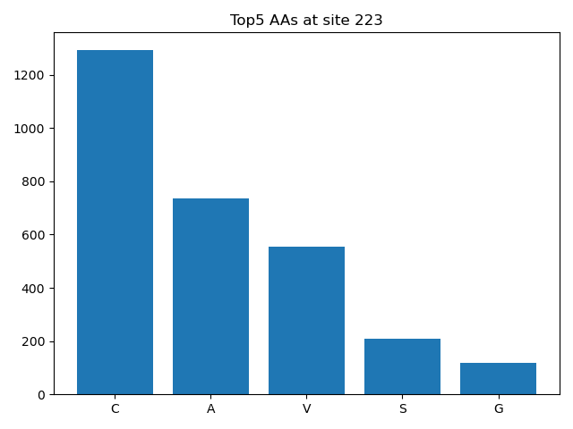
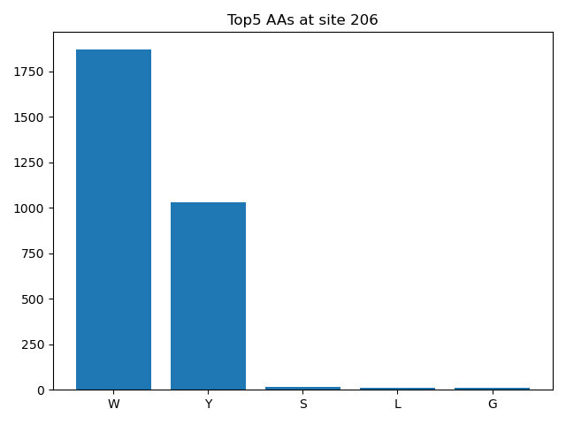
The Top 5 most occurring Amio Acids per site:
Reference:
 | 121 | 125 | 126 | 129 | 168 | 206 | 223
pBK Ma Pyl RS WT | L | L | Y | M | V | Y | A
Shows a High amount of variance at sites 129,121 and 223.
While Sites 126 and 168 are fairly variants.
Sites 125 and 206 are dominated by two distinct amino acids

Slide 3
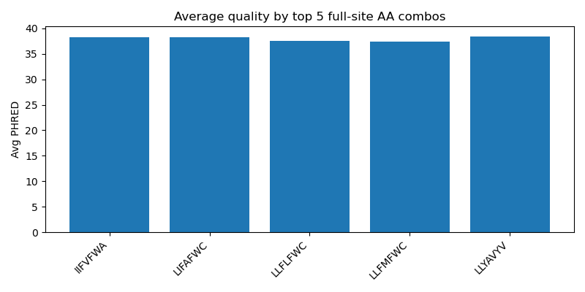
The Top 5 most occurring full-proteins compared for their Phred scores:
This analysis is only comparing the phred scores of the sequences that had all their sites present in the sequencing data. This baisis since the sequences that have all their sites are also likely to have a high PHRED score.
Regardless, it informs that the there aren’t any full-proteins with low phred score in the top 5 .

